Slide 1
Lecture 5
Dr. Lauren Chenarides
September 23, 2025

Slide 2
The only [wo]man who never makes a mistake is the [wo]man who never does anything. -Theodore “Teddy” Roosevelt (26th President of the U.S.)

Slide 3

Lecture 5: Opportunity Assessment
Textbook Reading (Quiz Basis)
Chapter 6. Assessment of Entrepreneurial Opportunities
Lecture Agenda
Part 1: Starting a New Venture
Part 2: Methods of Venture Evaluation

Slide 4
Chapter 6 Objectives
6.1 Explain the challenge of new-venture start-ups.
6.2 Review common pitfalls in the selection of new-venture ideas.
6.3 Present critical factors involved in new-venture development.
6.4 Study certain factors that underlie venture success.
6.5 Explain the critical need for an effective entrepreneurial team.
6.6 Examine why new ventures fail.
6.7 Analyze the traditional venture evaluation process methods: profile analysis, the feasibility criteria approach, and the comprehensive feasibility method.
6.8 Highlight the contemporary venture evaluation methods: design methodology and the Lean Start-Up methodology.
6.9 Present the importance of new-venture legitimacy and unique strategies for the differing audiences.

Slide 5
The Entrepreneur’s Journey
Weeks 1-4 (Recap)

Slide 6
So far…
Intro to Entrepreneurship
The Entrepreneurial Mindset
The Entr. Mindset in Corporations and Social Ventures
Creativity and Innovation
We’ve discussed characteristics of entrepreneurs, whether they are founders or working within an organization.
Companies with a strong mission and purpose seek to measure impact as well as financial performance.
Innovation is what happens when the creative process is applied to opportunities.

Slide 7
Innovations are at the center of new venture start-ups
Last time, we ended with innovation.
Creativity fuels the process of ideation, and innovation is the outcome entrepreneurs bring to market.
These can be:
Inventions
Extensions
Duplications
Synthesized concepts
This time, we’ll look at the venture creation process.

Slide 8
Key Questions Asked
What predicts the performance of successful new ventures?
What are common pitfalls of new ventures?
Why do new ventures fail?
How to test if an idea will work?
What are “low stakes” business models to get your idea off the ground?
Why is legitimacy important for new business ventures?

Slide 9
Starting a New Venture
Part 1

Slide 10
New-Venture Start-Ups
The number of new-venture start-ups has been consistently high at reports of more than 400,000 new firms in the United States every year since 2010.
The U.S. Patent Office currently receives more than 600,000 patent applications per year.
What is a patent?
A U.S. patent gives the inventor the right to “exclude others from making, using, offering for sale, or selling” an invention or “importing” it into the U.S. A plant patent gives you additional rights on the “parts” of plants (e.g., a plant patent on an apple variety would include rights on the apples from the plant variety). What is granted is not the right to make, use, offer for sale, sell or import the invention, but the right to stop others from doing so. If someone infringes on your patent, you may initiate legal action. U.S. patents are effective only within the U.S. and its territories and possessions.
Source: US Patents Office

Slide 11
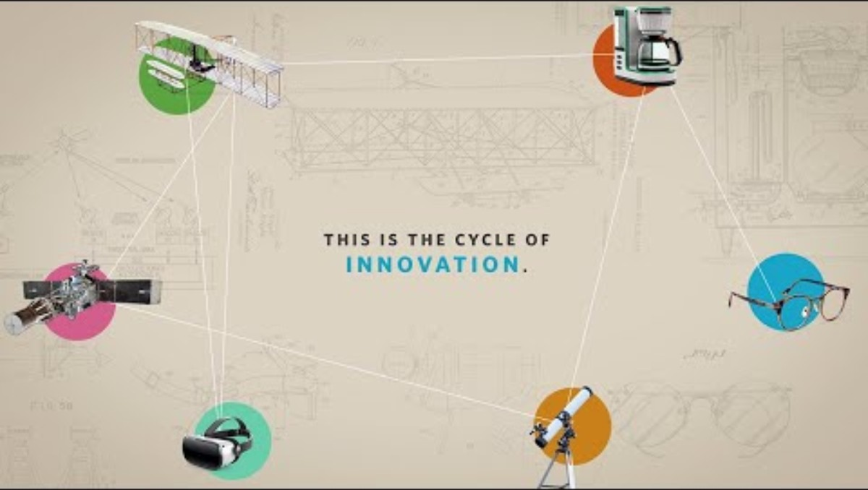

Slide 12
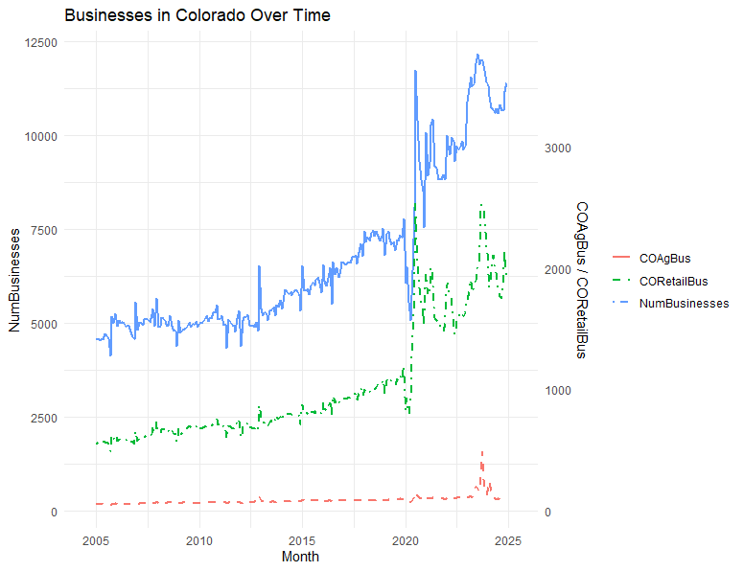
Figure plots the number of new businesses applications filed in Colorado (left axis) and the number of new business applications specifically in Agriculture (NAICS 11) & Retail Trade (NAICS 44-45) (right axis). Source: Business Formation Statistics Time Series / Trend Charts.

Slide 13

U.S. Patent Trends in Agriculture
Patent applications have risen 209% between 2020 to 2024.
This upward trend reflects growing innovation activity and heightened interest in intellectual property protection, signaling a robust and expanding patent landscape.
Leading categories of patents: Genetically engineered seeds, automated machinery and drones, climate-smart platforms, CRISPR and gene-editing tools
Source: Retrieved through Derwent Innovation

Slide 14
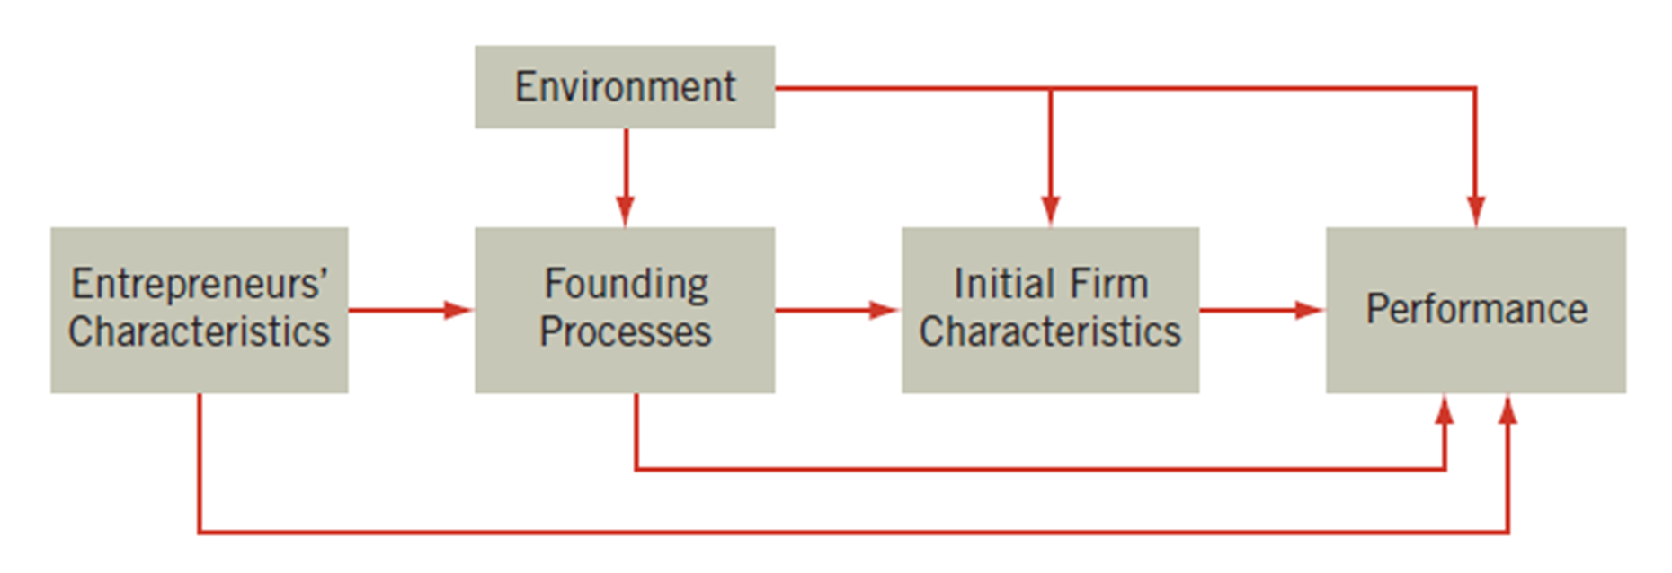
What predicts the performance of new-venture creation?
Entrepreneurial Motivations
Personal characteristics
The environment
The venture
Successful Start-Up Characteristics
More aggressive in making their business real
Undertake more activities than others
Act with more intensity
Make use of professional advice
Develop more detailed business plans
Obtain legitimacy with early stakeholders
Do you see how the entrepreneurial characteristics show up here?
Source: Arnold C. Cooper, “Challenges in Predicting New Firm Performance,” Journal of Business Venturing 8, no. 3 (1993): 243.
Notes:
Do I have the characteristics to start a business? (Or am I willing to hone them?)
Is the environment ready for this new venture?
Do I have the resources required to bring this venture to market?

Slide 15
Common Pitfalls of New Ventures (1 of 2)
Lack of objective evaluation
All ideas need rigorous review. This happens through customer discovery, trial-and-error, and simply seeking feedback.
No real insight into the market
Need to understand the timing of product introduction and the product life cycle.
Inadequate understanding of technical requirements
Unexpected technical difficulties can be costly and time consuming.

Slide 16
Common Pitfalls of New Ventures (2 of 2)
Poor financial understanding
The needed financing is often underestimated.
Lack of venture uniqueness
Should provide a product or service that is superior to that of the competition.
Ignorance of legal issues
Need to be aware of safety requirements, patents, trademarks, and other legal issues.

Slide 17
Group Activity 5-1
Work in groups of two.
Each person should write down three business or product ideas. These could be real or made-up. They do not need to be reasonable.
Trade ideas and evaluate each one you received based on what might be the challenge with introducing that idea. Select the one from the list that you believe is most viable.
Trade back and share insights and thoughts.
Notes:
Students can work in groups of two or three. Each person writes down three business or product ideas. These could be real ideas or they could be imaginary. They do not need to be possible, and could even relate to aliens! Trade lists. With the list that a student received, consider what would be most challenging aspect of that idea. Also, note which of the three you would consider most viable. The group should then share insights and thoughts.

Slide 18
A New-Venture Idea Checklist
Operations of the Venture
1. What personnel are needed?
2. Describe the operational procedures.
3. What is the preferred location?
Venture Management
1. What is the background and experience of the lead entrepreneur?
2. Explain the qualifications of each key person on the management team?
3. How will each person be compensated?
Venture Financing
1. How much funding will be needed?
2. What sources of funding will be pursued?
Competition & Risks
1. What is the nature of the competition?
2. Are there specific risks inherent in this venture?
Venture Feasibility
1. Is the concept possible?
2. Is the concept legal?
Value Proposition
1. Identify the specific competitive advantages of the concept?
2. What is unique about this venture idea?
3. Are the unique advantages sustainable?
Potential Market
1. What is the market niche?
2. Who would be the specific customers targeted?
3. Is this a reachable and reasonable customer market?
Marketing the Venture
1. What is the estimated share of market will the venture capture?
2. How will sales be accomplished?
3. Pricing? How does the price compare to competitors?
4. What are the distribution channels—retail, online, social media?
Source: Karl H. Vesper, New Venture Strategies (Revised Edition), 1st Edition, © 1990. Reprinted by permission of Pearson Education, Inc., Upper Saddle River, NJ.
Notes:
Table 6.1
Source: Karl H. Vesper, New Venture Strategies, (Revised Edition), 1st Edition, © 1990. Reprinted by permission of Pearson Education, Inc., Upper Saddle River, NJ.

Slide 19
Critical Factors for New-Venture Success (1 of 2)
1. Uniqueness
Is your idea unique enough to stand out?
2. Investment
How much money will it take to get started?
3. Growth of Sales
Can sales grow steadily?

Slide 20
Critical Factors for New-Venture Success (2 of 2)
4. Product Availability
Do you actually have something to sell when you launch?
Problems can occur because the product or service is still in development and needs further modification or testing. For example, “bugs” in a software firm.
5. Customer Availability
Do you know who your customers are and their buying habits?

Slide 21
Phases in New-Venture Start-Ups
Pre-Start-Up Phase
Begins with an idea for the venture.
Starts with the initiation of sales activity and the delivery of products and services.
Post-Start-Up Phase
Starts when the company is viable.
Start-Up Phase
Ends when the business is firmly established and beyond short-term threats to survival.
Ends when the doors are opened for business.
Lasts until the venture is terminated or is no longer controlled by an entrepreneur.
Notes:
Pre–start-Up Phase
Begins with an idea for the venture and ends when the doors are opened for business.
Start-Up Phase
Commences with the initiation of sales activity and the delivery of products and services, and ends when the business is firmly established and beyond short-term threats to survival.
Post–start-Up Phase
Lasts until the venture is terminated or the surviving organizational entity is no longer controlled by an entrepreneur.

Slide 22

Developing an Effective Entrepreneurial Team
Entrepreneurial teams are central to successful introduction of new venture.
Collaboration among team members is critical.
Team should be considered as a dynamic entity that is continually reevaluated.

Slide 23
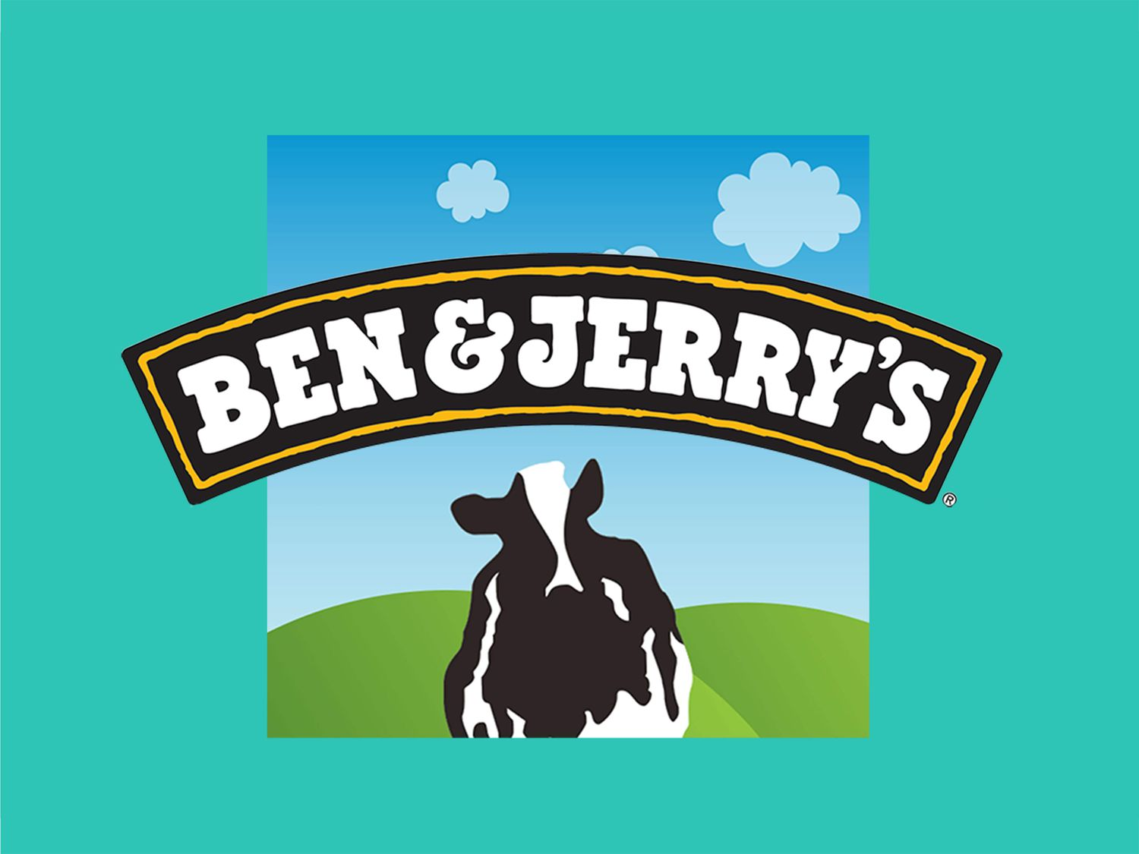

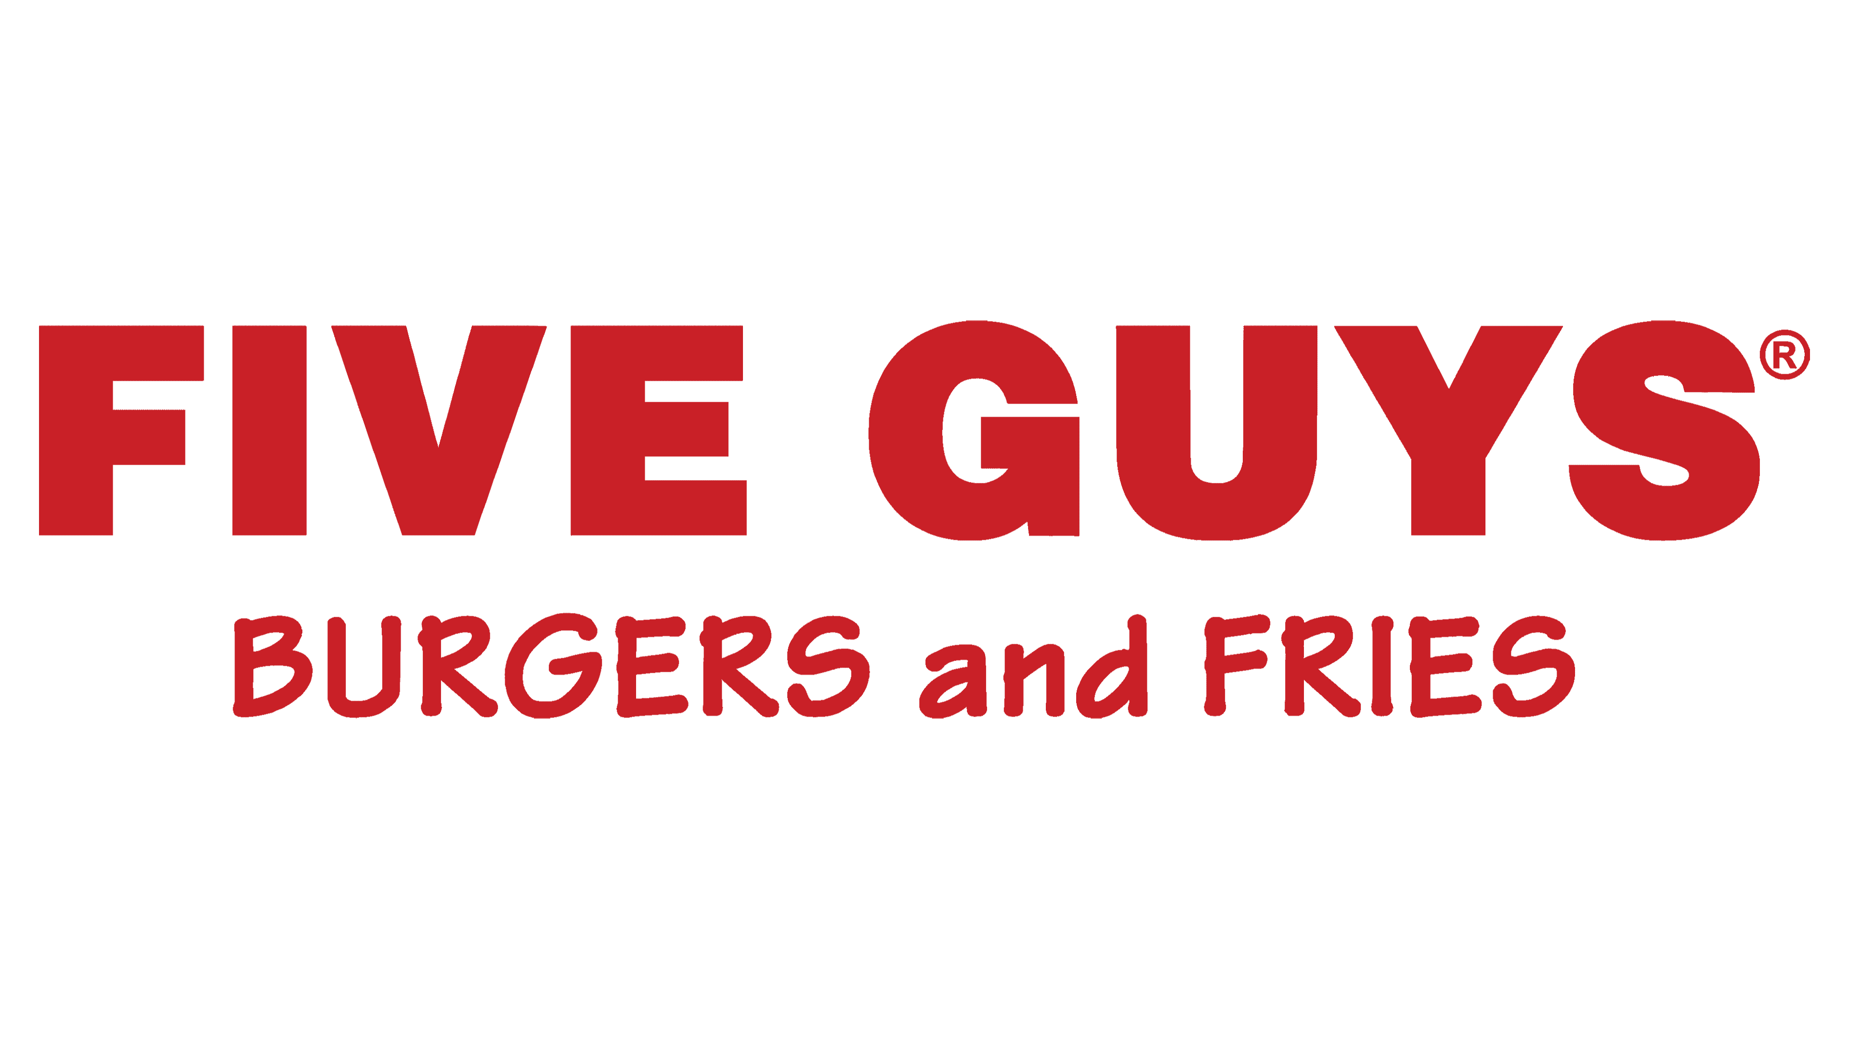
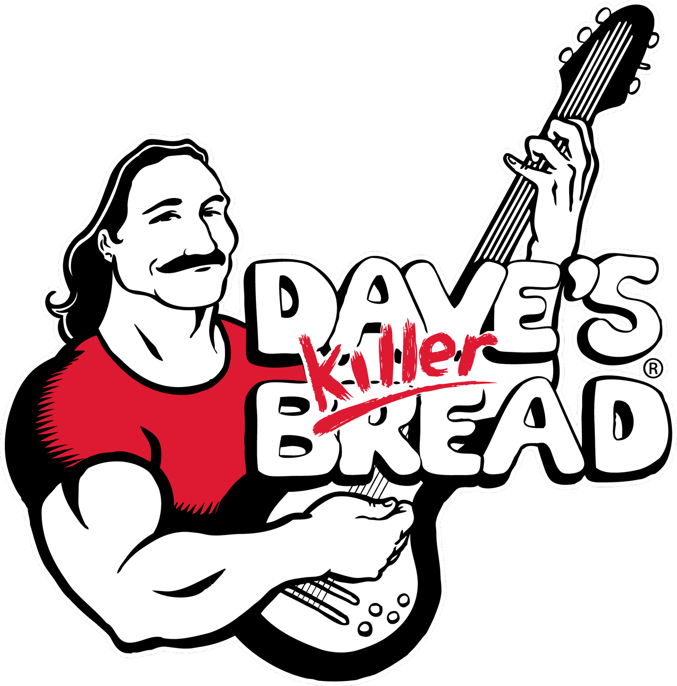

Notes:
Food companies with co-founders:
Ben & Jerry's: Co-founded in 1978 by childhood friends Ben Cohen and Jerry Greenfield in a renovated gas station in Burlington, Vermont. Their brand's success was built on a shared passion for food and a commitment to their community.
Whole Foods Market: Co-founders John Mackey and Renee Lawson started a small vegetarian natural foods store in Austin, Texas, in 1975. After merging with another local grocer in 1978, it became Whole Foods Market.
Five Guys: In 1986, Jerry Murrell and his wife, Janie, opened a burger restaurant in Arlington, Virginia. The "five guys" in the name originally referred to Jerry and his four sons, with a fifth son later joining the family business.
Pizza Hut: The international pizza chain was started in 1958 by brothers Frank and Dan Carney, who were students at Wichita University at the time.
Dave's Killer Bread: This popular organic bread brand was co-founded by Dave Dahl, an ex-convict, along with his family.

Slide 24
Why New Ventures Fail
One research study examined 250 high-tech firms and found three major categories of causes for failure:
Product/Market Problems
Poor timing
Product design problems
Inappropriate distribution strategy
Unclear business definition
Overreliance on one customer
Financial Difficulties
Initial undercapitalization
Assuming debt too early
Venture capital relationship problems
Managerial Problems
Concept of a team approach
Human resource problems
Notes:
Product/Market Problems
Financial Difficulties
Managerial Problems

Slide 25
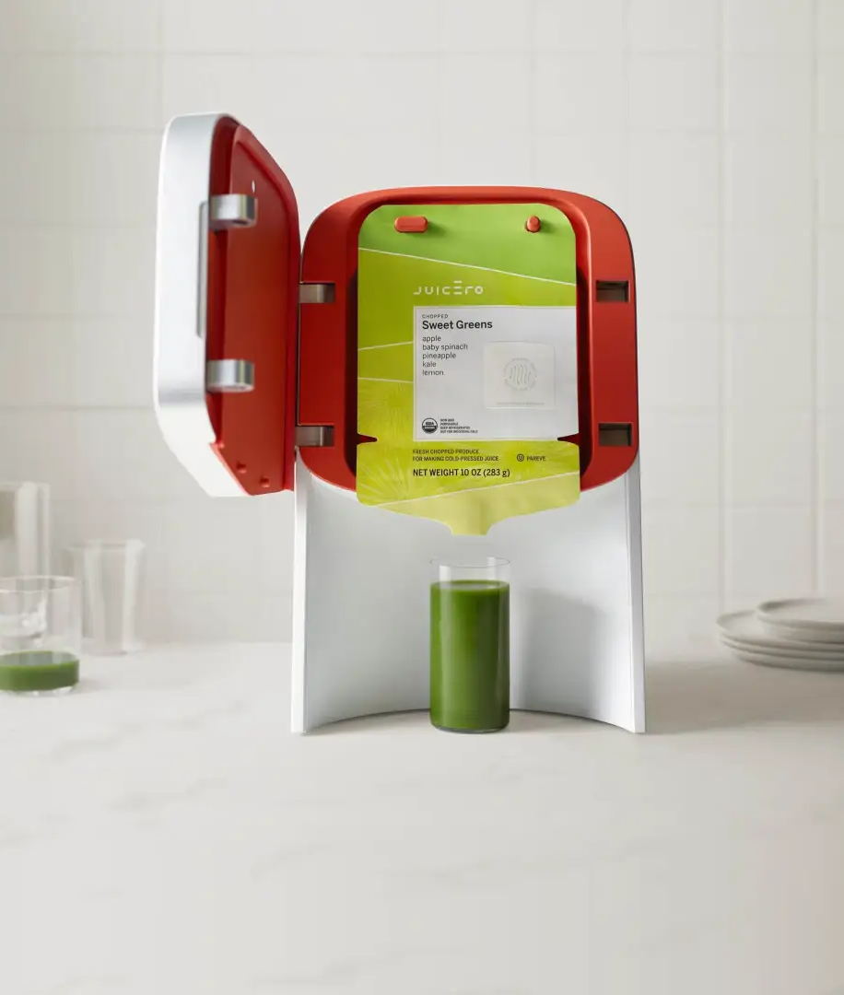
Juicero
A $700 internet-connected juicer designed to press proprietary juice packs.
The problem: Customers discovered they could squeeze the juice packs by hand—no machine required. The design created no real value for the consumer.
Why it failed:
Over-engineered product that solved a non-problem.
High cost relative to alternatives (blenders, pre-bottled juice).
Mismatch with customer needs—consumers wanted convenience and health, not an expensive gadget tied to proprietary packs.
Outcome: Despite $120M in venture funding, Juicero shut down in 2017, becoming a case study in poor product-market fit.
Notes:
Juicero was a tech startup that designed and sold an expensive, Wi-Fi-enabled juicer, only to fail after it was discovered that its proprietary juice packets could be squeezed by hand. The company, which raised $120 million in venture capital, has since become an infamous symbol of Silicon Valley excess and the failure to solve a non-existent problem.

Slide 26
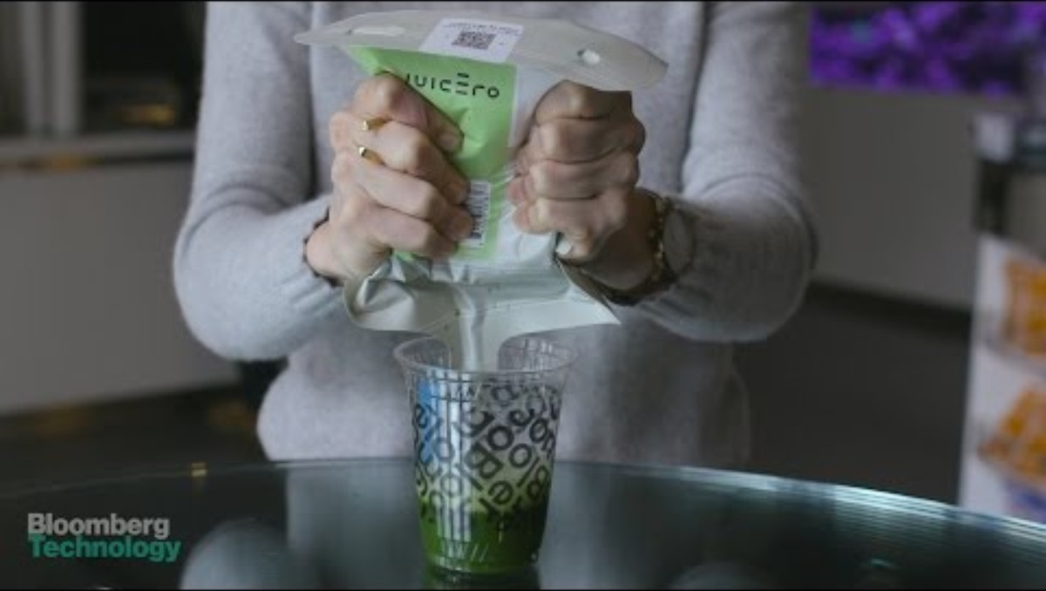

Slide 27
First-Year Start-Up Problems
Financing – raising funds, managing cash flow
Sales/Marketing – low sales, customer dependence, weak promotion
Product Development – building products/services that fit the market
Operations – supply chain, quality control, resource constraints
Management – inexperience, growth challenges, admin issues
Human Resources – hiring, retention, morale, development
External Factors – economy, regulations
Source: David E. Terpstra and Philip D. Olson, “Entrepreneurial Start-up and Growth: A Classification of Problems,” Entrepreneurship Theory and Practice 17, no. 3 (Spring 1993): 19.
Notes:
Table 6.2
Source: David E. Terpstra and Philip D. Olson, “Entrepreneurial Start-Up and Growth: A Classification of Problems,” Entrepreneurship Theory and Practice 17, no. 3 (Spring 1993): 19.

Slide 28
Group Activity 5-2
Each group will read their example of a new venture that failed.
What might have been some issues with that venture?
Share your findings with the class.
Notes:
Each group should research a business or product that failed. The groups should strive to find what elements caused the failure. Each group can then share with the class.

Slide 29
A fourth category: “Failure Prediction Model”
Definition: Failure Prediction Model
This model predicts failure when firms are both small and financially fragile, growing at the wrong pace, lacking cash flow, and unable to manage debt.
Too much debt and too small (poor static solidity)
Growing at the wrong speed (too fast without enough money; too slow to cover costs)
Not enough sales coming in (poor dynamic liquidity)
Not enough cash on hand to cover day-to-day expenses (dynamic solidity)
Source: Erkki K. Laitinen, “Prediction of Failure of a Newly Founded Firm,” Journal of Business Venturing 7, no. 4 (1992): 326-28.
Notes:
Product/Market Problems
Financial Difficulties
Managerial Problems

Slide 30



How Incubators & Accelerators Help
Programs exist to lower the cost, time, and risk of starting new ventures.
Provide shared space, basic resources, and access to mentors to build a capable team.
Guide funding estimates, connect ventures with grants, investors, and competitions.
Offer market intelligence, legal/regulatory support, and peer learning.
Help validate the idea technically and legally through expert review and testing.
Support customer discovery, refine the venture’s “why us,” and identify reachable markets.
Advise on pricing, distribution channels, and strategies to reach first customers.

Slide 31
Feasibility analysis: Testing if an idea can work (1 of 2)
1. Profile Analysis Approach
Looks at the internal strengths and weaknesses of the business: finances, marketing, operations, and people.
Helps identify where the team is strong and where gaps may limit growth.
2. Feasibility Criteria Approach
Uses a checklist of key questions: Is the product proprietary? Are costs realistic? Is there a real customer?
Provides a structured way to test assumptions about the product and its market.

Slide 32
Feasibility analysis: Testing if an idea can work (2 of 2)
3. Comprehensive Feasibility Approach
Expands the view to include external factors: technical, market, financial, organizational, and competitive.
Here, we focus on two:
Technical Feasibility – Can the product be built reliably, safely, and at reasonable cost?
Marketability – Will customers buy it, at a price that makes sense, in a competitive industry?

Slide 33
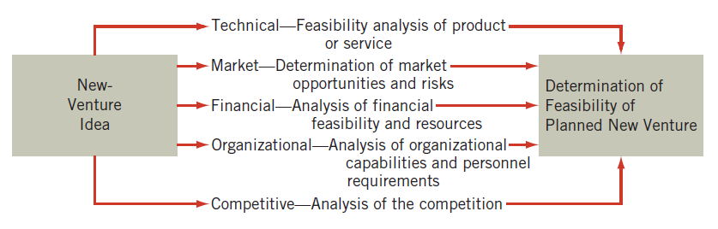
Comprehensive Feasibility Approach
Notes:
Figure 6.2

Slide 34
Technical Feasibility
These ensure the product actually works for customers under real-world conditions.
Functional design of the product and attractiveness in appearance
Flexibility, permitting ready modification of the external features of the product to meet customer demands or technological and competitive changes
Durability of the materials from which the product is made
Reliability, ensuring performance as expected under normal operating conditions
Product safety, posing no potential dangers under normal operating conditions
Reasonable utility, an acceptable rate of obsolescence
Ease and low cost of maintenance
Standardization through elimination of unnecessary variety among potentially interchangeable parts
Ease of processing or manufacture
Ease of handling and use

Slide 35
Marketability
These determine whether the product can survive and grow in the market.
General Economic Trends
Various economic indicators such as new orders, housing starts, inventories, and consumer spending
Market Data
Customers, customer demand patterns in seasonal variations in demand, and governmental regulations affecting demand
Pricing Data
Range of prices for the same, complementary, and substitute products; base prices; and discount structures
Competitive Data
Major competitors and their competitive strength

Slide 36
Putting it all together
A solid feasibility analysis means testing your idea from all angles:
inside the business (team, finances, operations)
the product itself (can it be built well?)
and the outside world (is there real demand and a competitive place in the market?)
If any angle reveals a fatal flaw—like costs too high, no customer demand, or a product that can’t be built safely—then the entrepreneur knows to pivot, adjust, or walk away before sinking too much into a failing idea.

Slide 37
Methods of Venture Evaluation
Part 2

Slide 38
Contemporary Approaches to Venture Evaluation
Traditional feasibility analyses focus mainly on financials and forecasts.
Modern methods add design, experimentation, and customer feedback to reduce risk.
Two leading approaches:
Design Methodology – emphasizes concept design, prototyping, and stakeholder feedback to prove feasibility, desirability, and viability.
Lean Startup Methodology – emphasizes fast iteration, minimum viable products (MVPs), and customer learning to avoid wasted effort.
Bottom line: Both methods are about testing and adapting ideas early so entrepreneurs can spot fatal flaws and pivot before it’s too late.
Notes:
Why new methods?

Slide 39
The Design Methodology
Takes an initial concept idea and develops a proof of concept that elicits feedback from relevant stakeholders.
A process that converts ideas into form, whether that is a plan of action, an experience, or a physical thing.
An initial concept taken and developed into a proof of concept that elicits:
Proof of concept feasibility
Proof of concept desirability
Proof of concept viability

Slide 40
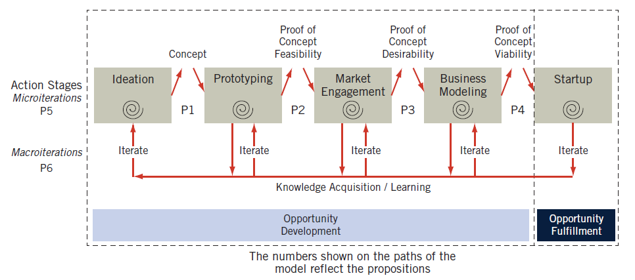
Design-Centered Entrepreneurship
Source: Michael G. Goldsby, Donald F. Kuratko, Matthew R. Marvel, and Thomas Nelson, “Design-Centered Entrepreneurship: A Four Stage Iterative Process for Opportunity Development,” Journal of Small Business & Entrepreneurship 29, no. 6 (2017): 5.
Notes:
Taking action and learning that culminates in a venture concept for further development.
Applying a prototyping stage that addresses the technical issues of the concept, and ensures that a feasible product or service can be made and delivered.
Incorporating microiterations (within each action stage to improve the outcome) and macroiterations (moving from one particular action stage back to a previous stage for further development).
Figure 6.3
Source: Michael G. Goldsby, Donald F. Kuratko, Matthew R. Marvel, and Thomas Nelson, “Design-Centered Entrepreneurship: A Four Stage Iterative Process for Opportunity Development,” Journal of Small Business and Entrepreneurship 29, no. 6 (2017): 5.

Slide 41
Design-Centered Entrepreneurship
Taking action and learning that culminates in a venture concept for further development.
Applying a prototyping stage that addresses the technical issues of the concept, and ensures that a feasible product or service can be made and delivered.
Incorporating microiterations (within each action stage to improve the outcome) and macroiterations (moving from one particular action stage back to a previous stage for further development).

Slide 42
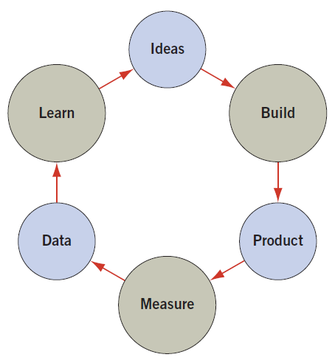
The Lean Startup Methodology
A modern way to launch businesses that emphasizes experimenting, learning, and adapting quickly instead of spending years writing long business plans.
The goal is to reduce wasted time and money by testing ideas early with customers.
Uses the Build–Measure–Learn feedback loop:
Build – create a small version of the product.
Measure – see how customers react.
Learn – decide whether to keep going, improve, or change direction.
Source: Eric Ries, The Lean Startup: How Today’s Entrepreneurs Use Continuous Innovation to Create Radically Successful Businesses (New York, NY: Crown Business, 2011).
Notes:
Figure 6.4
Source: Eric Ries, The Lean Startup: How Today’s Entrepreneurs Use Continuous Innovation to Create Radically Successful Businesses (New York: Crown Business, 2011).

Slide 43
Key Terms
Minimum Viable Product (MVP):
The simplest version of a product that still delivers value to customers.
Built to test a key assumption or idea as quickly and cheaply as possible.
Example: Instead of building a full food-delivery app, first test demand with a simple website and phone ordering.
Pivot:
A structured change in direction based on what you learned from customers.
You keep the vision (solve the problem) but change the approach.
Example: A snack company discovers customers don’t like the protein bar, but they love the same ingredients as a drink → pivot from bars to shakes.

Slide 44
Group Activity 5-3
Work in groups of five or six.
Ideally, sit in a circle, or decide on an order among the group members.
The first person should write down a product idea, and pass it to the next person.
The second person would add how to build it.
The third person would add how the product might actually turn out.
Continue with testing, test results, product modification, and then the new idea. Continue!
Notes:
Work in groups of five or six, ideally in a circle. The group should decide on an order. Using a large piece of paper, the first person would write down a product idea, then pass it along. The second would write down how to build it. The third would consider the final product when built. The group will continue with testing, test results, product modification, then a new idea and keep going. Each item should only be a sentence or two, even a bullet point would be fine. The group should continue to see the product modification process.

Slide 45
New-Venture Legitimacy
What it is:
Being seen as credible so investors, customers, and partners trust you.
Why it matters:
Without legitimacy, startups struggle to raise money, hire people, or gain partners.
Who cares (Audiences):
Government (regulations)
Investors (ROI, professionalism)
Corporates (partnership fit)
Crowdfunding (community support)
How to build it:
Follow the rules (Conformance): fit in with expectations.
Pick the right setting (Selection): enter an industry or community that supports you.
Match the environment (Manipulation): show you “belong” through alignment.
Set new rules (Creation): create your own norms or standards.
Tools (Mechanisms):
Identity – brand, symbols, storytelling
Associations – credible partners, endorsements
Organization – strong leadership, clear success metrics
Notes:
Think of a startup you know—how did they convince others they were “legit”? (Example: Impossible Foods → gained legitimacy by partnering with Burger King).

Slide 46
Summary
6.1 Explain the challenge of new-venture start-ups.
6.2 Review common pitfalls in the selection of new-venture ideas.
6.3 Present critical factors involved in new-venture development.
6.4 Study certain factors that underlie venture success.
6.5 Explain the critical need for an effective entrepreneurial team.
6.6 Examine why new ventures fail.
6.7 Analyze the traditional venture evaluation process methods: profile analysis, the feasibility criteria approach, and the comprehensive feasibility method.
6.8 Highlight the contemporary venture evaluation methods: design methodology and the Lean Start-Up methodology.
6.9 Present the importance of new-venture legitimacy and unique strategies for the differing audiences.

